Slide 1
Machine Learning MCA 5152
Rohini R. Rao
Department of Computer Applications
MIT, Manipal
August 2021
Slide Set 1 - Introduction

Slide 2
Contents
History
Definition of ML
Types of Learning
Supervised Learning
Unsupervised Learning
Reinforcement Learning
Terminology
Hypothesis Space
Inductive Bias
Inductive Learning & Generalization
Model Evaluation & Selection
Bias & Variance
Parametric vs. Non Parametric Models
Model Selection
No free lunch theories

Slide 3
History
1950s – Arthur Samuel’s checkers playing games
1960s
Rosenblatt proposed a perceptron
Delta Learning Rule
Minsky and Papert
1970s
Symbolic concept of Induction
Expert systems
Ross Quinlan’s ID3
Symbolic Natural Language Processing
Notes:
Machine which is as capable as humans. Artificial Intelligence .
The main driver of the machine was a search tree of the board positions reachable from the current state. Since he had only a very limited amount of available computer memory, Samuel implemented what is now called alpha-beta pruning
Rosenblatt – perceptron illustrates fundamental properties of intelligent systems, without becoming enmeshed in special and frequently unknown conditions. an electronic device which was constructed with biological principles and showed an ability to learn. initially simulated on an IBM 704 computer at Cornell Aeronautical Laboratory in 1957.^{[7]} When a triangle was held before the perceptron's eye, it would pick up the image and convey it along a random succession of lines to the response units, where the image was registered
Delta learning rule or least square problem- the delta rule is a gradient descent learning rule for updating the weights of the inputs to artificial neurons in a single-layer neural network.
Induction where a system tries to induce a general rule from a set of observed instances.
Minsky – limitations of perceptron, said the perceptron cannot handle XOR problem , inseperable data distributions cannot be handled.
Symbolic AI uses human-readable symbols that represent real-world entities or concepts as well as logic (the mathematically provable logical methods) in order to create ‘rules’ for the concrete manipulation of those symbols, leading to a rule-based system.

Slide 4
History
1980s
Advanced Decision Trees and Rule Learning
Resurgence in Neural Networks – Back Propagation
Werbos - Multilayer Perceptron Networks
Valiant’s Probably Approximate Correct Learning (PAC) Learning Theory – experimental methodology
1990s
Vapnik, Cortes – Support Vector Machines, Kernels in 2000
Data Mining
Freund & Shapire – ADA Boost – create a strong classifier from an ensemble of weak classifiers
Bremen - Random Forest - 2001
Bayes Net
Adaptive Agents and Web Applications
Notes:
Williams and Neilson worked on Back Propogation.
Valiant’s
SVM had empirical results.

Slide 5
History
2000s
Deep Learning
New Hardware – GPUS
Cloud Enabled
Availability of Big Data
Milestones
1997 – Deep Blue beat Gary Kasparov in a game of chess
2009 – Google built Self Driving Cars
2011 – IBM’s Watson won the popular game of jeopardy
2014 – Human Vision surpassed by ML vision

Slide 6
Programmatic Vs. Machine Learning Solution
Data Program
Output
Data Output
Program or Learning
to solve subsequent tasks
COMPUTER
COMPUTER

Slide 7
Formal Definition of Machine Learning
Arthur Samuel (1959).
Field of study that gives computers the ability to learn without being explicitly programmed.
Tom Mitchel (1998)
A computer program is said to learn
from experience E
with respect to some task T
and some performance measure P,
if its performance on T, as measured by P, improves with experience E.
Notes:
Suppose your email program watches which emails you do or do not mark as spam, and based on that learns how to better filter spam. What is the task T in this setting?
“

Slide 8
Definition of Machine Learning
Experiences/Data
Problem/Task
LEARNER
Models
REASONER
Background Knowledge/Bias
Answer/Performance
Notes:
We have to choose the training data. What is the target function or how to represent the model. Ex – given a board position what move to make.
Choose a learning algorithm that will infer the target function

Slide 9
Types of Learning
Supervised learning
predict y from x
Given a labelled set of input-output pairs, Map input x to output y
Given: Training set {(x_{i} , y_{i} ) | i = 1 … n}
Find: A good approximation to
f : X → Y
Classification – y is categorical
Regression – y is real values
Examples - spam detection, Digit Recognition, stock prices

Slide 10
Supervised Learning

Slide 11
Types of Learning
Unsupervised learning
model p(x), evaluate how likely x is, understand x
Find interesting patterns or knowledge discovery
clustering, patterns

Slide 12
Types of Learning
Reinforcement learning
Agent is acting in an environment.
Needs learn action to take at every step
Action depends on reward or punishment signals that the agent gets in each state
Notes:
Rlearner learns policy. Not only for short term reward but overall utility of agent over time horizon is optimized

Slide 13
Terminology
Feature Space represents the data in a set of n features
Features are properties that describe each instance in Instance space
Multiple features represented in a Feature Vector
We are given data and induction identifies a function, which can explain the data.
Hypothesis could be a function which is a line or curve which separates classes.
Hypothesis Space
is the set of all legal functions that are solutions to the task
Comprises of the features chosen and the language or the class of functions

Slide 14
Terminology

Slide 15
Hypothesis language - representations

Slide 16
Inductive Bias
Need to make assumptions
Experience alone does not allow us to make conclusions about unseen data instances
Examples
Occam’s Razor
prefer the simplest hypothesis.
Philosophical principle that if something can be described in a short language that hypothesis is to be preferred over a more complex hypothesis.
minimum description length
Maximum margin
Two types of Bias
Restriction :
Limit the Hypothesis space
For instance, Hypothesis language reflects the inductive bias of the learner
Preference
Impose ordering on Hypothesis Space

Slide 17
Inductive Learning
Inducing a general function from training examples.
Given some training examples, the objective is to generalize to test data
Construct hypothesis h to agree with c on the training examples.
Consistent Hypothesis agrees with all training examples.
hypothesis that is consistence with all the training examples
A hypothesis is said to generalize well if it correctly predicts the value of y for novel example.
Inductive Learning is an ill posed problem
where the data by itself is not sufficient to find a unique solutions
inductive learning hypothesis
A hypothesis which has a low training error over a sufficiently large training set is expected to do well on unseen examples.

Slide 18
Formal Definition of Learning
function approximation.
We assume y = f(x) for
some unknown function f
The goal of learning is to estimate the function f
given a labeled training set
then to make predictions using ŷ = f(x).
Generalization
to make predictions on novel inputs, meaning ones that we have not seen before
Leslie Kielbling

Slide 19
Need for Probabilistic Prediction
the probability distribution over possible labels
given the input vector x and training set D is p(y|x,D)
If there are just two classes
it is sufficient to return the single number p(y = 1|x,D)
since p(y = 1|x,D) + p(y =0|x,D) = 1.)
MAP Estimate (Maximum A Posteriori estimate)
Most probable class

Slide 20
Experimental Evaluation of Learning Algorithms
Evaluating the performance of learning systems is important because
Learning systems are designed to predict the class of future unlabeled data points
Experimental Valuation include
Error
Accuracy
Precision/Recall
Typical Choices for Sampling Methods
Train/test sets
Error or other parameters is measured on the training set
the error or accuracy on the training set is not, may not be a reflection of the true error
K-fold Cross-validation

Slide 21
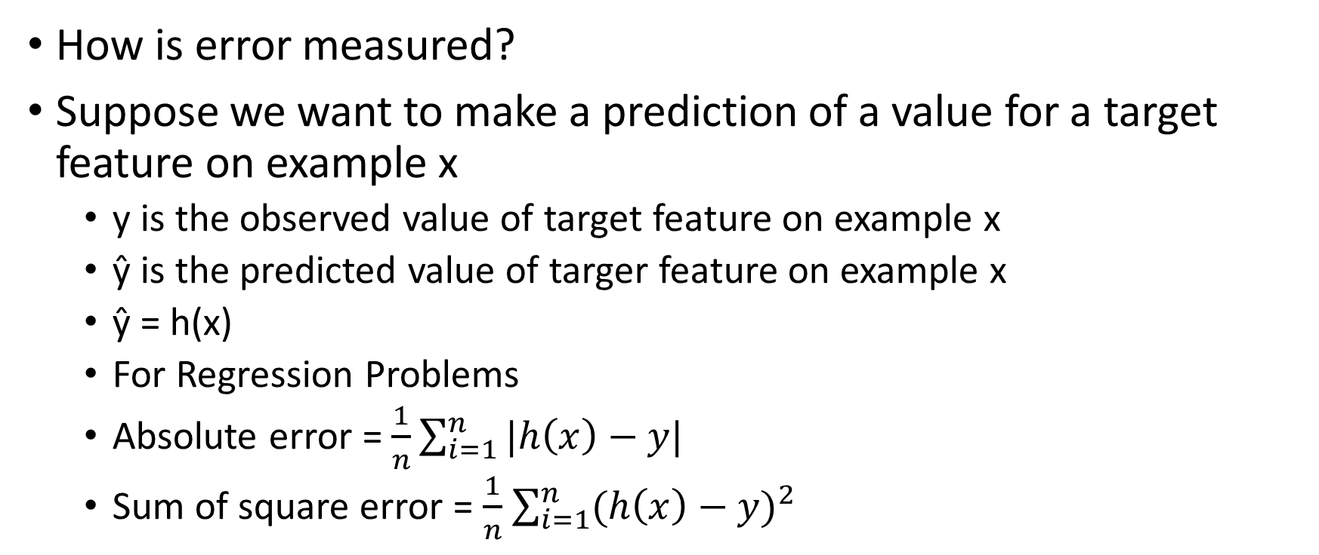
Model Evaluation
How is error measured?
Suppose we want to make a prediction of a value for a target feature on example x
y is the observed value of target feature on example x
ŷ is the predicted value of targer feature on example x
ŷ = h(x)
For Regression Problems
Absolute error = $\frac{1}{n}\sum_{i=1}^{n}{|h\left(x\right)−y|}$
Sum of square error = $\frac{1}{n}$ $\sum_{i=1}^{n}{{(h\left(x\right)−y)}^{2}}$

Slide 22
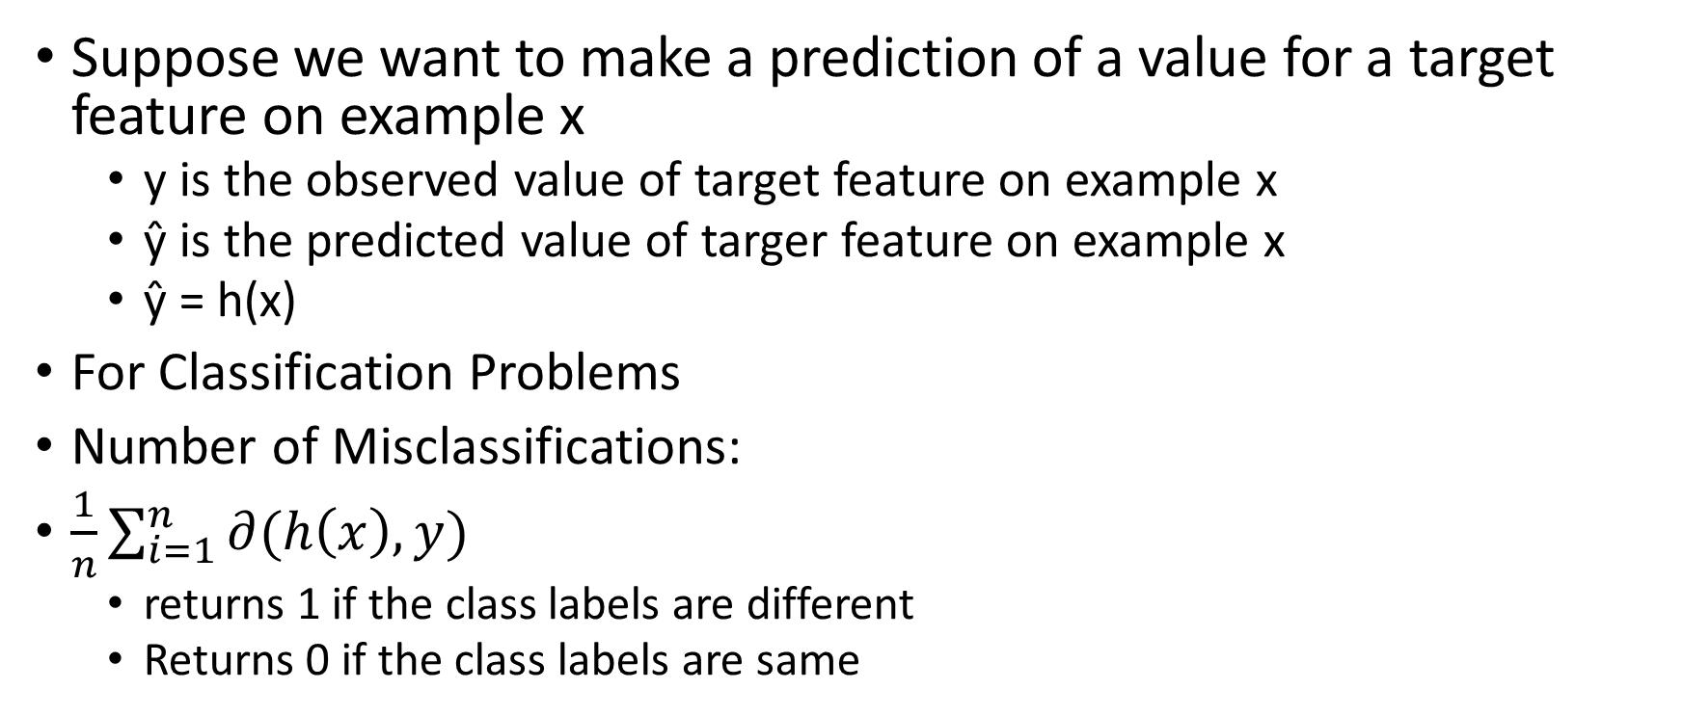
Model Evaluation
Suppose we want to make a prediction of a value for a target feature on example x
y is the observed value of target feature on example x
ŷ is the predicted value of targer feature on example x
ŷ = h(x)
For Classification Problems
Number of Misclassifications:
$\frac{1}{n}\sum_{i=1}^{n}{∂(h\left(x\right),y)}$
returns 1 if the class labels are different
Returns 0 if the class labels are same

Slide 23

Model Evaluation in Classification
Accuracy = $\frac{TP+TN}{P+N}$
Precision = $\frac{TP}{TP+FP}$
Recall =$\frac{TP}{P}$
True Class ------------------------------------→
Hypothesis Class-→
TP | FP
FN | TN
P
N

Slide 24
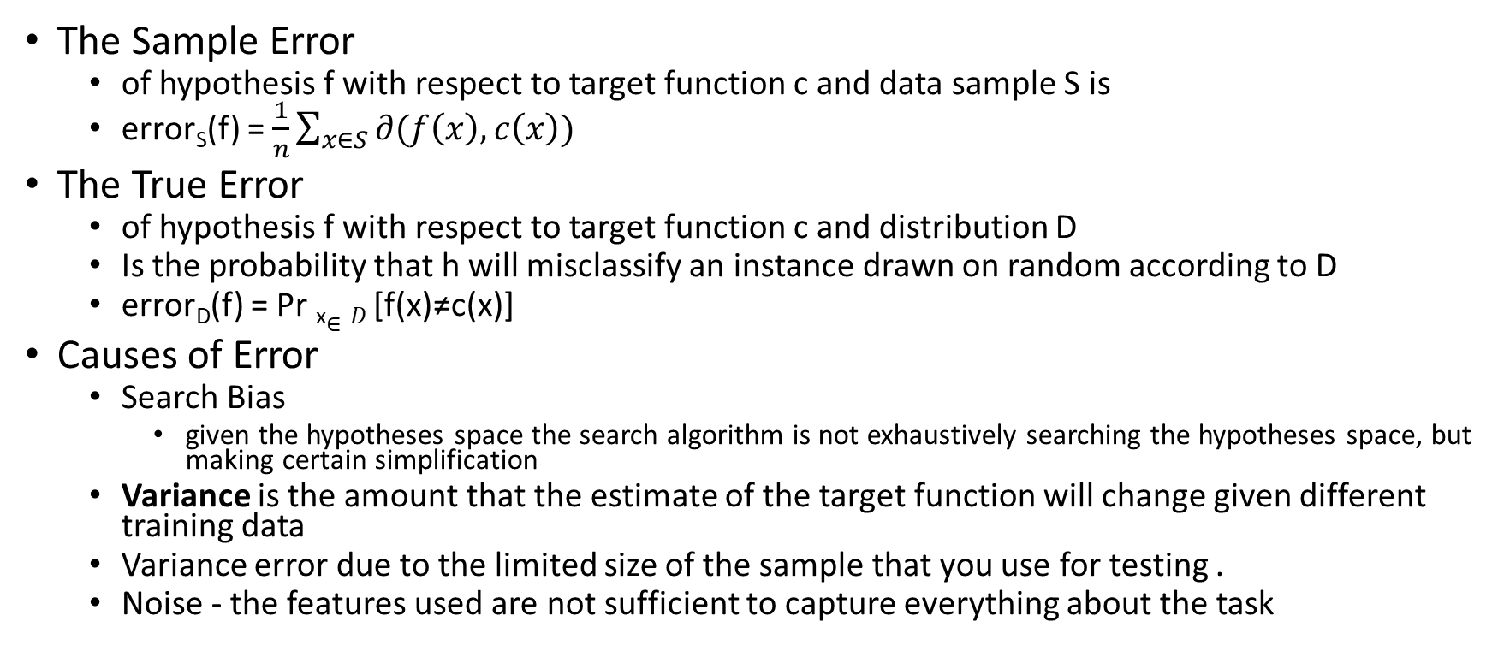
Sample Error vs True Error
The Sample Error
of hypothesis f with respect to target function c and data sample S is
error_{S}(f) = $\frac{1}{n}\sum_{x∈S}{∂(f\left(x\right),c\left(x\right))}$
The True Error
of hypothesis f with respect to target function c and distribution D
Is the probability that h will misclassify an instance drawn on random according to D
error_{D}(f) = Pr _{x}$∈D$ [f(x)≠c(x)]
Causes of Error
Search Bias
given the hypotheses space the search algorithm is not exhaustively searching the hypotheses space, but making certain simplification
Variance is the amount that the estimate of the target function will change given different training data
Variance error due to the limited size of the sample that you use for testing .
Noise - the features used are not sufficient to capture everything about the task

Slide 25
Bias & Variance
Bias
We use a set for training and you use a disjoint set of examples for testing
Ideally both the training set and the test set are drawn from the distribution.
Variance
If the test set is small there will be variance.
The accuracy may be very high or very low on that set.
If we have a larger test set the variance will be smaller.
Validation

Slide 26
K fold cross validation
Validation set used to tune model parameters

Slide 27
Model Selection in the KNN case
We care about generalization error or test error
Test error (Red Line)
U-shaped curve
for complex models (small K), the method overfits
simple models (big K), the method underfits
Use validation test to pick K
Pick the value with the minimum error on the test set
K = 10 to 100

Slide 28
Machine Learning Trade-off
In ML there is always are trade-off between
Complex hypothesis that fit the training data well
Simpler hypothesis that may generalize better
As the amount of training data increases, the generalization error decreases
No Free Lunch Algorithm (Wolpert 1996).
All models are wrong, but some models are useful. — George Box (Box and Draper 1987
As a consequence of the no free lunch theorem
Need to develop many different types of models
to cover the wide variety of data that occurs in the real world.
For each model, there may be many different algorithms we can use to train the model
Then make speed-accuracy-complexity tradeoffs.

Slide 29
Developing a learning algorithm
To improve the learning algorithm

Slide 33
Bias vs. Variance

Slide 34
Bias Vs Variance

Slide 35
Diagnosing Bias vs Variance

Slide 36
Learning Curves

Slide 37
High Bias vs. High Variance

Slide 38
Solutions

Slide 39
Parametric vs Non Parametric Models
Parametric model
A learning model that summarizes data with a set of parameters of fixed size
independent of the number of training examples.
Faster to use
but making stronger assumptions
Examples
Linear Regression
Logistic Regression
Naive Bayes

Slide 40
Parametric vs Non Parametric Models
Nonparametric model
Model with lot of data and no prior knowledge
no need to choose the right features.
more flexible, but often computationally intractable
Examples
Decision Trees
K-Nearest Neighbor
Support Vector Machines with Gaussian Kernels

Slide 41
References
Kevin P. Murphy, Machine Learning: A Probabilistic Perspective, MIT Press, 2012.
Introduction to Machine Learning – Prof. Sudeshna Sarkar,
Week 1: Introduction: Basic definitions, types of learning, hypothesis space and inductive bias, evaluation, cross-validation

